Slide 1
Classification By Yaohang Li, Ph.D. Department of Computer Science Old Dominion University yaohang@cs.odu.edu

Slide 2
Introduction to Classification
The Classification Problem
Decision Tree
Random Forest
Logistic regression
Support Vector Machine (SVM)
Some slides are modified from Liu Bo

Slide 3
Classification Learning
Regression learning – learning continuous functions
Classification learning – learning discrete-valued functions
Boolean classification: classification of examples is positive (T) or negative (F)
Multi-class classification: there are multiple classes for examples

Slide 4
Definition of Classification Learning
Data: A set of data records (also called examples, instances or cases) described by
n attributes: A₁, A₂, … A_{n}.
a class label: Each example is labelled with a pre-defined class.
Goal: To learn a classification model from the data that can be used to predict the classes of new (future, or test) cases/instances.

Slide 5
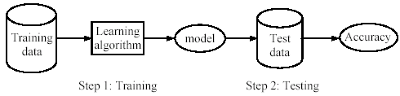
Supervised learning process
Training: Learn a model using the training data
Testing: Test the model using unseen test data to assess the model accuracy

Slide 6
The Assumption of Classification Learning
Assumption: The distribution of training examples is identical to the distribution of the test examples (including future unseen examples)
Often violated to certain extent in practice
Strong violation will result in poor classification
To achieve good classification performance, the training examples must be well representative of the test

Slide 7
Introduction to Classification
The Classification Problem
Decision Tree
Random Forest
Logistic regression
Support Vector Machine (SVM)

Slide 8
Decision Tree
A decision tree
one of the most widely used techniques for classification
competitive with other methods
very efficient
takes as input an example described by a set of attributes and returns a “decision” – the predicted output value for the input
the classification model is a tree

Slide 9
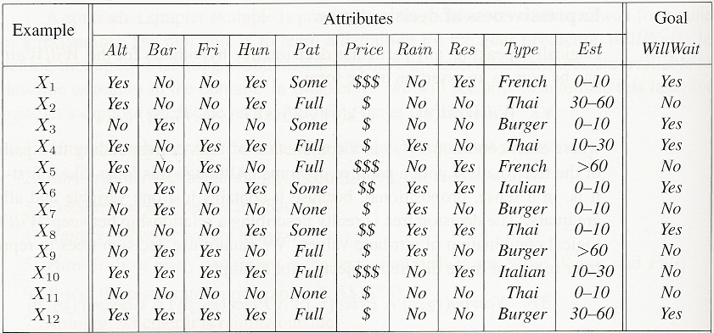
An example
Whether to wait for a table at a restaurant
To learn a definition for the goal predicate WillWait
Need attributes that describes examples in the domain

Slide 10
Attributes for restaurant problem
Alternate: whether there is a suitable alternative restaurant nearby
Bar: whether the restaurant has a comfortable bar area to wait in
Fri/Sat: true on Fridays and Saturdays
Hungry: whether we are hungry
Patrons: how many people are in the restaurant (values are None, Some, and Full)
Price: the restaurant’s price range ($, $$, $$$)
Raining: whether it is raining outside
Reservation: whether we made a reservation
Type: the kind of restaurant (French, Italian, Thai, or burger)
WaitEstimate: wait estimated by the host (0-10 minutes, 10-30, 30-60, >60)

Slide 11
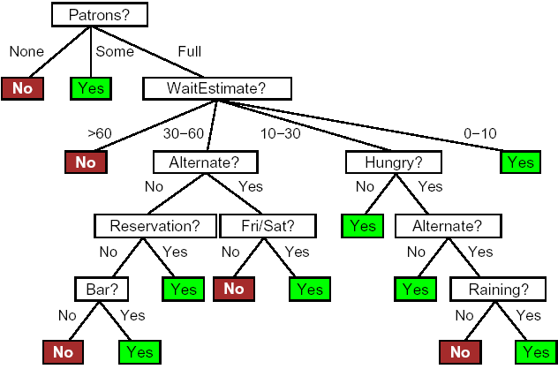
A Decision for the Restaurant Example
Making decision by performing a sequence of tests
Each internal node in the tree corresponds to a test of the value of one of the attributes
Branches for the node are labeled with possible values of the test
Each leaf node specifies the value to be returned (if it is reached)
A decision does not use the Price and Type attributes --considering them to be irrelevant

Slide 12
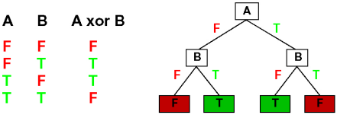
Expressiveness of decision trees
Decision trees can express any Boolean function
truth table row -> path to leaf

Slide 13
Which Tree is the best?
The decision tree is not unique
There are many possible trees that can fit a given training set
Which tree is the best?
We can build a trivial decision tree for any training set with one path to leaf for each example
just memorizes the observations, i.e., does not extract any pattern (rule), so it cannot extrapolate (generalize) to new (it has not seen) examples

Slide 14
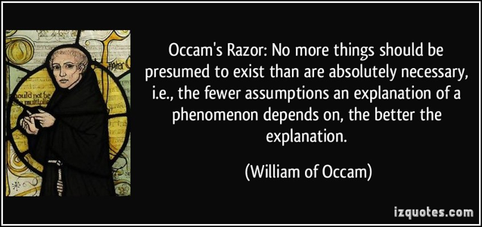
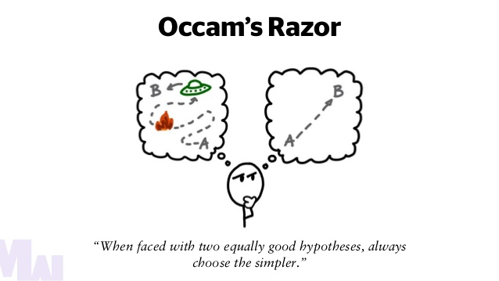
Occam’s Razor
”If two theories explain the facts equally well, then the simpler theory is to be preferred”
Arguments in favor:
Fewer short hypotheses than long hypotheses
A short hypothesis that fits the data is unlikely to be a coincidence
A long hypothesis that fits the data might be a coincidence
Arguments opposed:
There are many ways to define small sets of hypotheses

Slide 15
Which Tree is the best?
There are many possible trees that can fit a given training set
Which tree is the best?
We should find the smallest decision tree that is consistent with the examples
finding the smallest is intractable ☹
NP-hard
how to find a “smallish” (compact) one?
to test the most important (efficient) attribute first

Slide 16
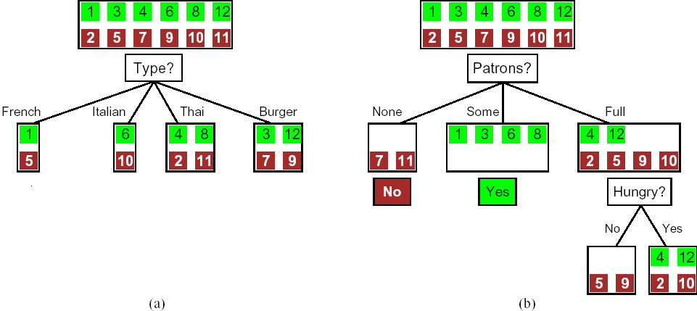
Choosing an attribute
Idea: a good attribute splits the examples into subsets that are (ideally) “all positive” or “all negative”
Patron? is a better choice because it leaves us with example sets for which we can answer definitively (Yes/No)

Slide 17
Which Attribute is the Best?
Information Theory
The attribute leads to most ”information gain”
Measures
Information gain
Entropy
Gini Index

Slide 18
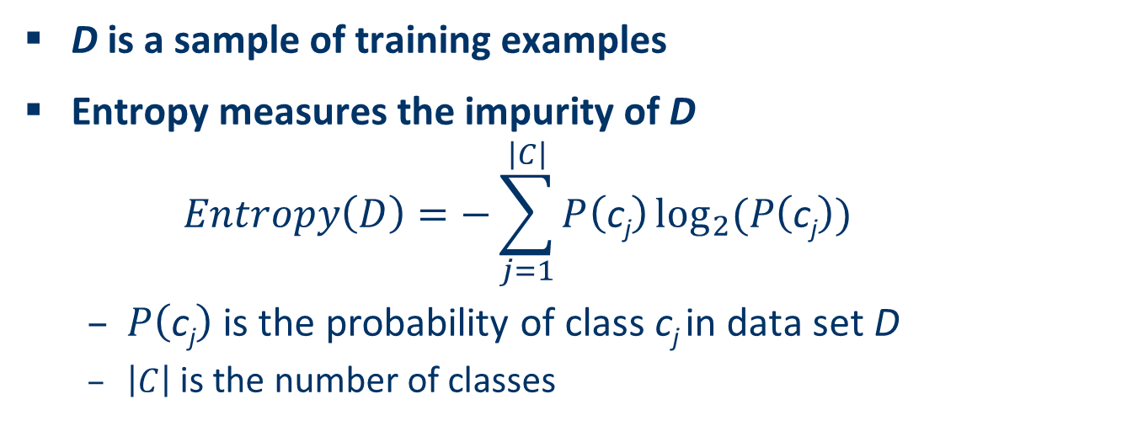
Entropy
D is a sample of training examples
Entropy measures the impurity of D
$$Entropy\left(D\right)=−\sum_{j=1}^{\left|C\right|}{P\left(\text{c}\text{j}\right)}\log_{2}⁡(P\left(\text{c}\text{j}\right))$$
$P\left(\text{c}\text{j}\right)$ is the probability of class c_{j} in data set D
$\left|C\right|$ is the number of classes

Slide 19
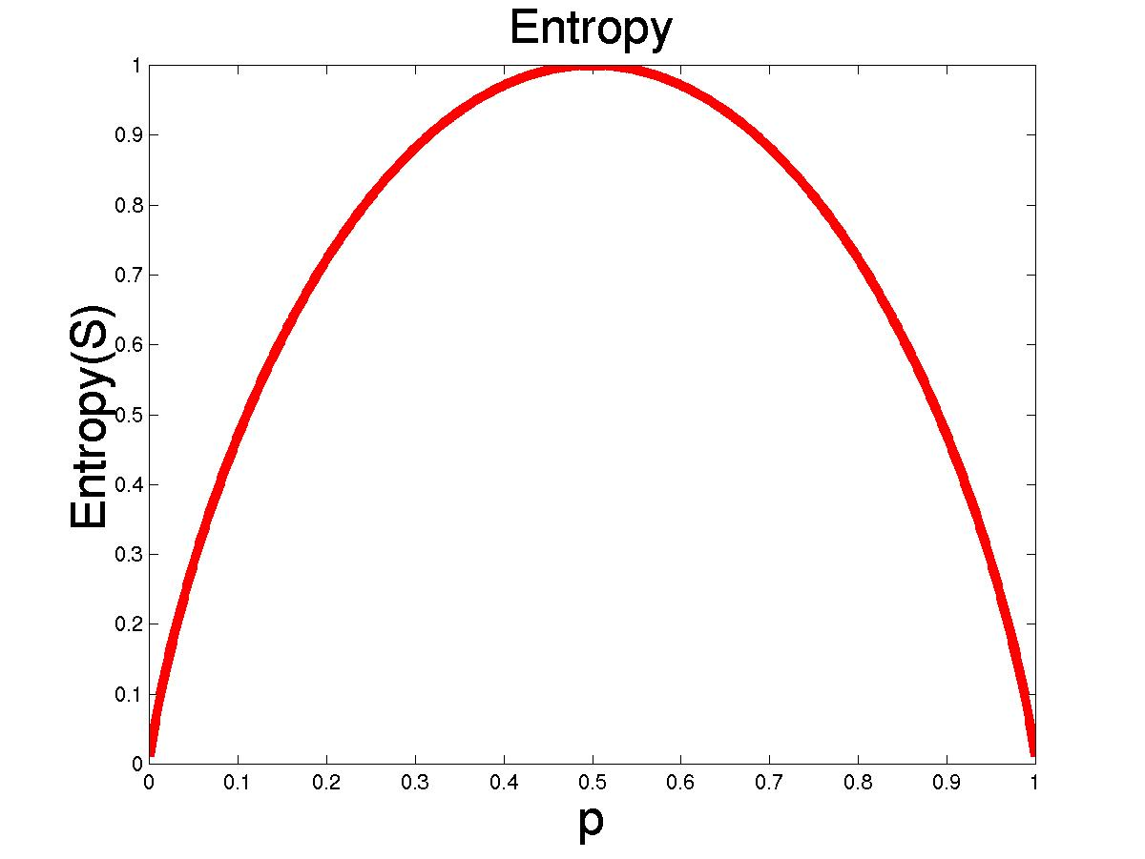
Explanation of Entropy
The dataset D has 50% positive samples and 50% negative samples
Entropy(D) = -0.5xlog₂0.5-0.5xlog₂0.5 = 1
The dataset D has 20% positive samples and 80% negative samples
Entropy(D) = -0.2xlog₂0.2-0.8xlog₂0.8 = 0.722
The dataset D has 100% positive samples and 0% negative samples
Entropy(D) = -1xlog₂1-0.0xlog₂0.0 = 0
As the data become purer and purer, the entropy value becomes smaller and smaller.

Slide 20
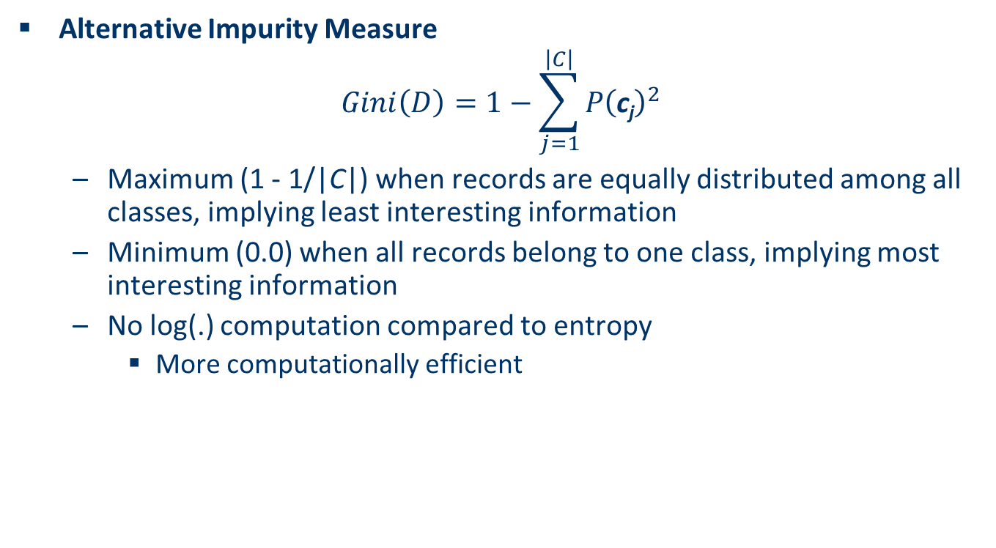
Gini Index
Alternative Impurity Measure
$$Gini\left(D\right)=1−\sum_{j=1}^{\left|C\right|}{{P\left(\text{c}\text{j}\right)}^{2}}$$
Maximum (1 - 1/|C|) when records are equally distributed among all classes, implying least interesting information
Minimum (0.0) when all records belong to one class, implying most interesting information
No log(.) computation compared to entropy
More computationally efficient

Slide 21
Gini Index Example
The dataset D has 50% positive samples and 50% negative samples
Gini(D) = 1-0.5*0.5-0.5*0.5 = 0.5
The dataset D has 20% positive samples and 80% negative samples
Gini(D) = 1-0.2*0.2-0.8*0.8 = 0.32
The dataset D has 100% positive samples and 0% negative samples
Gini(D) = 1-1*1-0*0 = 0.0

Slide 22
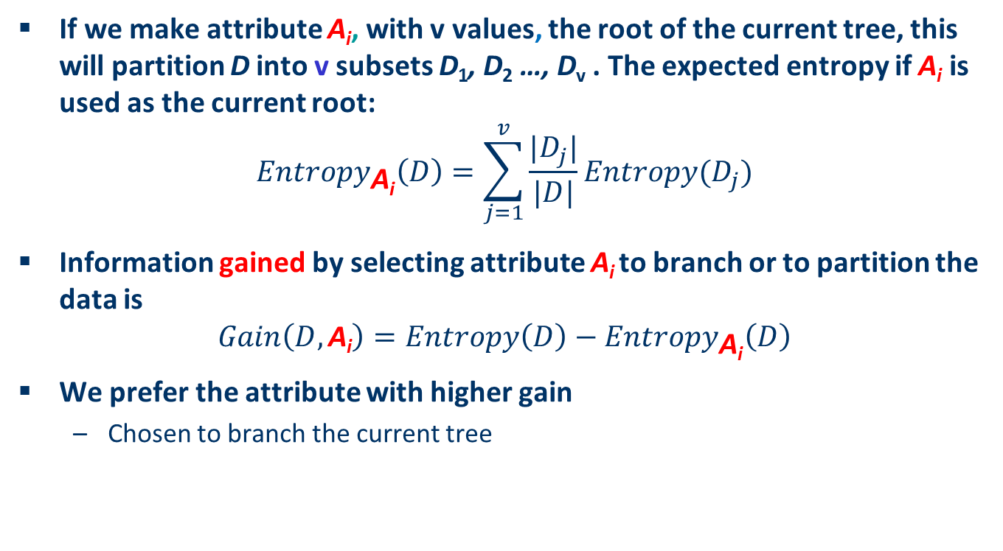
Information Gain
If we make attribute A_{i}, with v values, the root of the current tree, this will partition D into v subsets D₁, D₂ …, D_{v} . The expected entropy if A_{i} is used as the current root:
$${Entropy}_{\text{A}\text{i}}\left(D\right)=\sum_{j=1}^{v}{\frac{|D_{j}|}{|D|}}Entropy(D_{j})$$
Information gained by selecting attribute A_{i} to branch or to partition the data is
$$Gain\left(D,\text{A}\text{i}\right)=Entropy\left(D\right)−{Entropy}_{\text{A}\text{i}}\left(D\right)$$
We prefer the attribute with higher gain
Chosen to branch the current tree

Slide 23
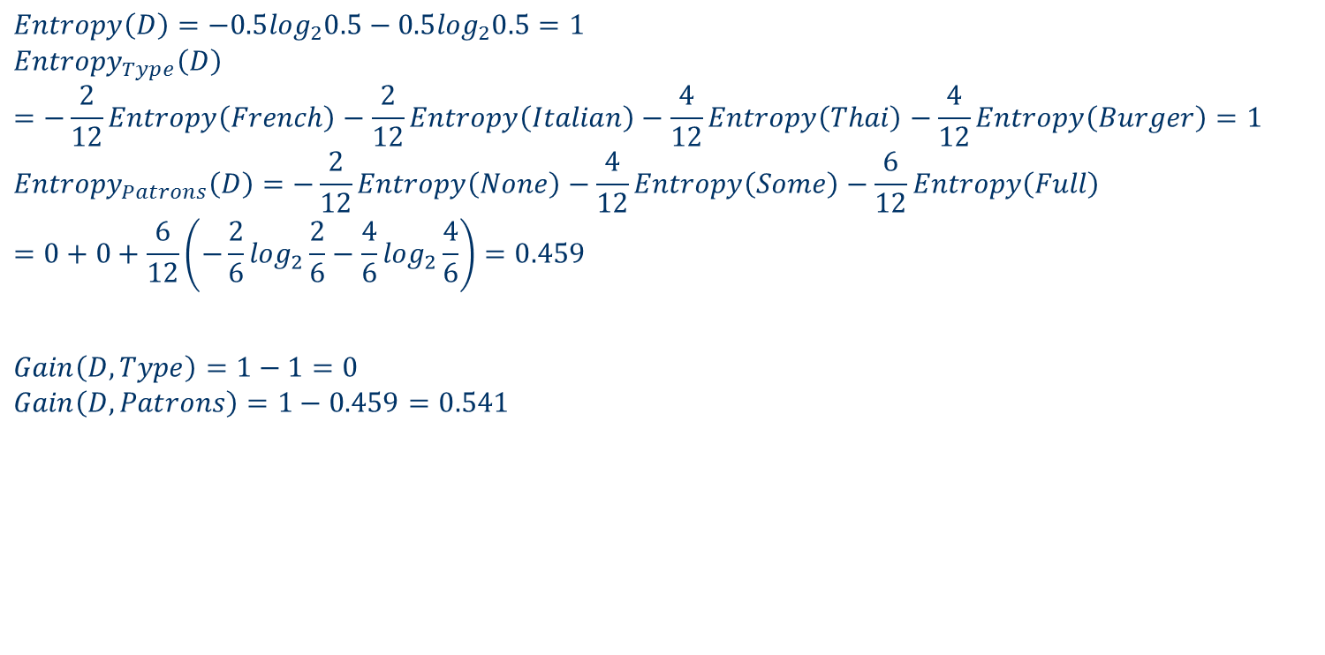
An Example
$$Entropy\left(D\right)=−0.5\log_{2}0.5−0.5\log_{2}0.5=1$$
$${Entropy}_{Type}\left(D\right)=−\frac{2}{12}Entropy\left(French\right)−\frac{2}{12}Entropy\left(Italian\right)−\frac{4}{12}Entropy\left(Thai\right)−\frac{4}{12}Entropy\left(Burger\right)=1$$
$${Entropy}_{Patrons}\left(D\right)=−\frac{2}{12}Entropy\left(None\right)−\frac{4}{12}Entropy\left(Some\right)−\frac{6}{12}Entropy\left(Full\right)=0+0+\frac{6}{12}\left(−\frac{2}{6}\log_{2}\frac{2}{6}−\frac{4}{6}\log_{2}\frac{4}{6}\right)=0.459$$
$$Gain\left(D, Type\right)=1−1=0$$
$$Gain\left(D, Patrons\right)=1−0.459=0.541$$

Slide 24
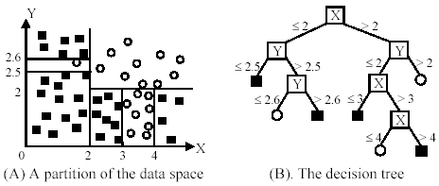
Continuous Variables
Continuous variables
Find a threshold to divide the interval with maximum information gain

Slide 25
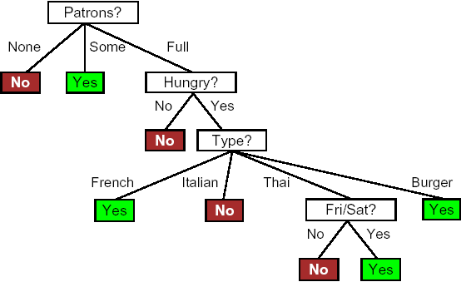
A Much Simpler Tree
After the first attribute test splits up the examples, each outcome is a new decision tree learning problem itself, with fewer examples and one fewer attribute.
Repeat the procedure will lead to the generation of a decision tree.
Learning algorithm does not include the test for Raining and Reservation?
That means either Raining/Reservation are not relevant or are represented by other variables.

Slide 26
Overfitting in Decision Trees
Overfitting: A tree may overfit the training data
Good accuracy on training data but poor on test data
Symptoms:
too deep and too many branches
anomalies due to noise or outliers

Slide 27
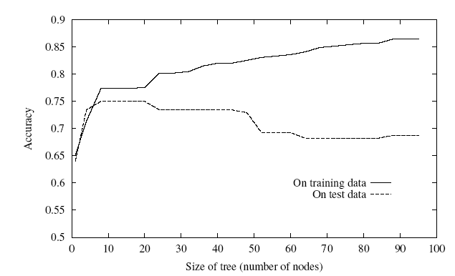
Underfitting and Overfitting in Decision Trees

Slide 28
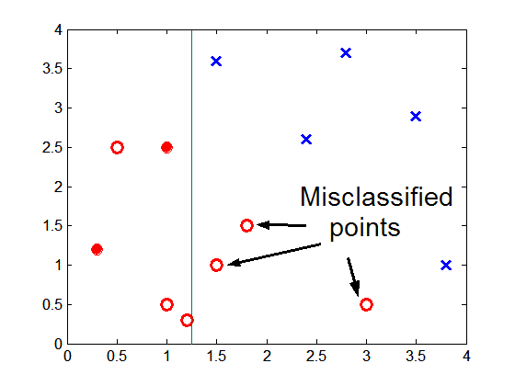
Underfitting due to Insufficient Samples
Insufficient samples lead to oversimplified decision boundary

Slide 29
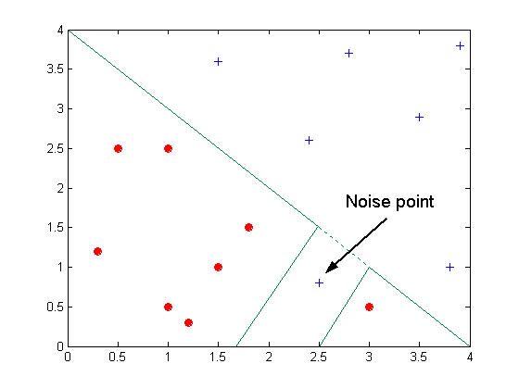
Overfitting due to Noise
A noise point distorts the decision boundary

Slide 30
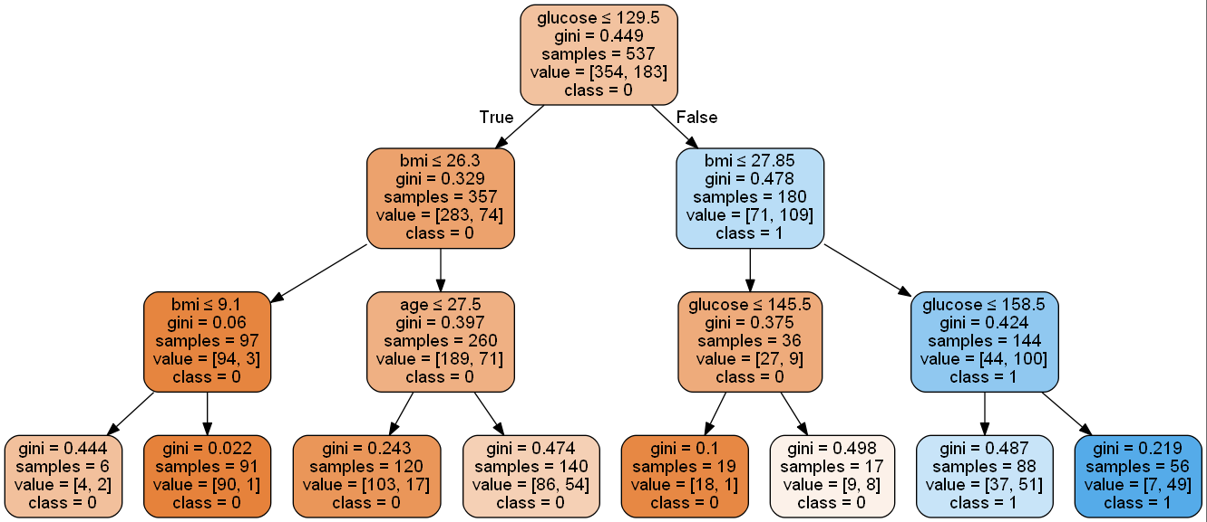
Demo
Decision tree for diabetes diagnose: decisiontree_diabetes

Slide 31
Disadvantages of Decision-Tree Learning
Large-Scale Information
A big decision tree
Not efficient
Contradictory information
Fail to build a decision tree
Decision tree is not robust to contradictory or erroneous information
Hard to handle noisy information
Missing Information
Not all the attributed values are known in some given examples
Hard to classify
Adaptability
Learning Decision Tree may not be useful in a changing environment
Real Time Response
If the decision tree is large, response time may be long

Slide 32
Introduction to Classification
The Classification Problem
Decision Tree
Random Forest
Logistic regression
Support Vector Machine (SVM)

Slide 33
Bagging and Random Forest Classifier
Bagging (Bootstrap aggregating)
A technique for reducing the variance of an estimated prediction function.
Application of bootstrap sampling
Given: a set D containing m training examples
Create k bootstrap samples S[1], S[2], …, S[k], each sample S[i] by drawing m examples at random with replacement from D
Build a distinct classifier on each S[i] to produce k classifiers, using the same learning algorithm.
Testing
Classify each new instance by majority voting of the k classifiers (equal weights)

Slide 34
Bagging and Random Forest Classifier
Random Forest
A committee of trees
Each cast a vote for the predicted class.
When the learner is unstable
Small change to training set causes large change in the output classifier
Experimentally, bagging can help substantially for unstable learners

Slide 35
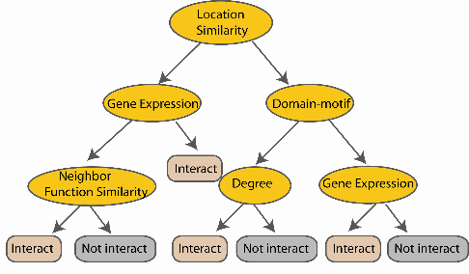
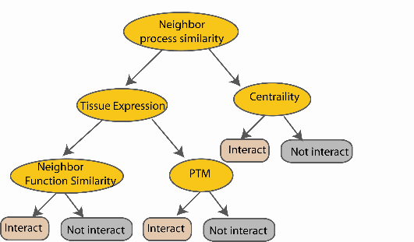
Random Forest Classifier
N examples
Take the majority vote
....…
....…

Slide 36
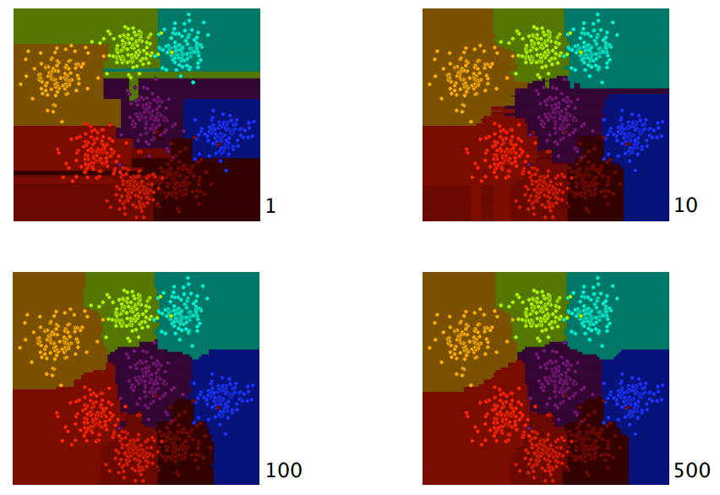
Effectiveness of Random Forest Classifier
Figure from Eric Debreuve

Slide 37
Demo
Jupyter Notebook rf_diabetes

Slide 38
Introduction to Classification
The Classification Problem
Decision Tree
Random Forest
Logistic regression
Support Vector Machine (SVM)

Slide 39
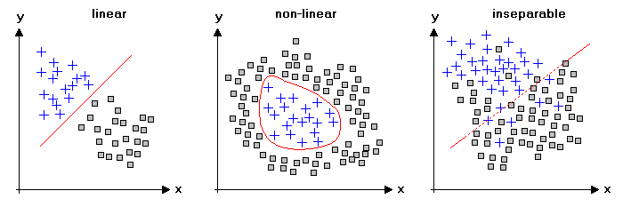
Binary Classification
Binary Classification
To separate the two classes
Separable Classes
Linear separable
Non-linear separable
Inseparable

Slide 40
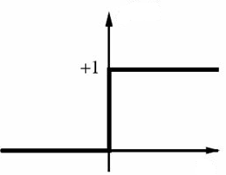
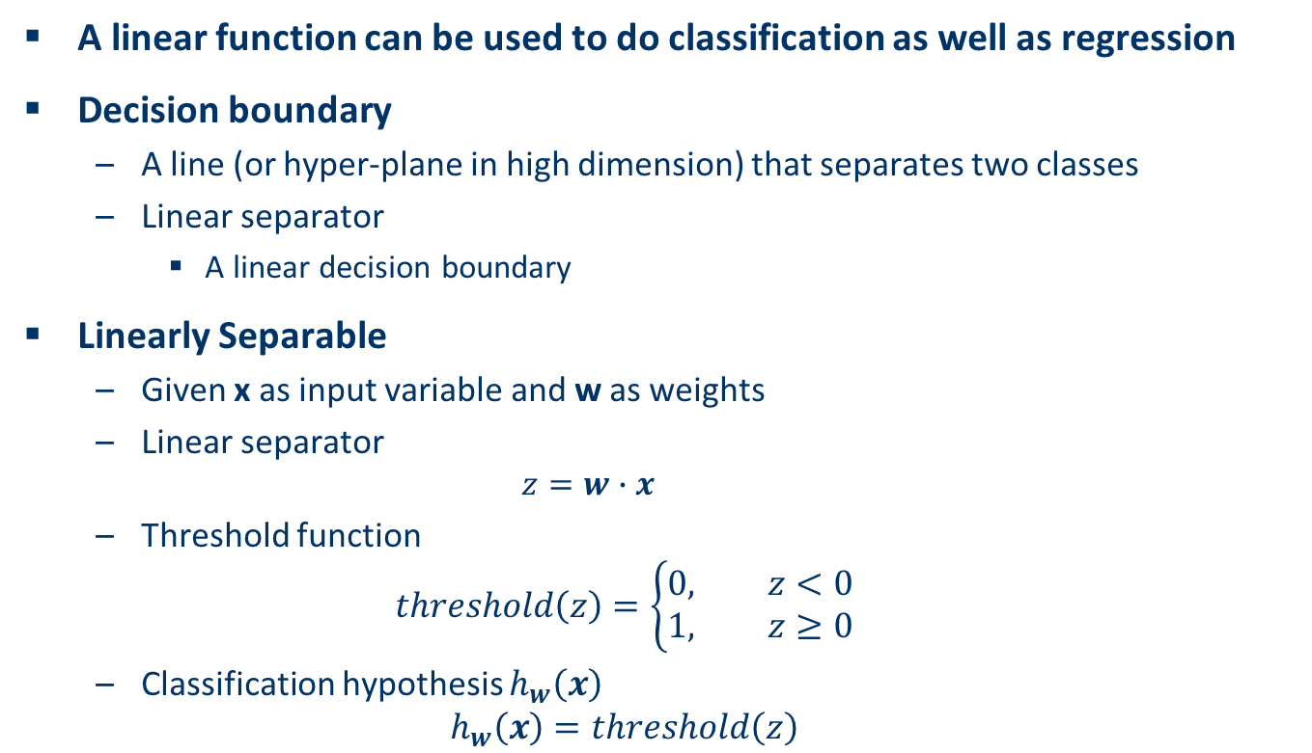
Linearly Separable
A linear function can be used to do classification as well as regression
Decision boundary
A line (or hyper-plane in high dimension) that separates two classes
Linear separator
A linear decision boundary
Linearly Separable
Given x as input variable and w as weights
Linear separator
$$z=w∙x$$
Threshold function
$$threshold\left(z\right)=\left\{\begin{aligned}0, z<0 \\ &1, z≥0\end{aligned}\right.$$
Classification hypothesis $h_{w}\left(x\right)$
$$h_{w}\left(x\right)=threshold\left(z\right)$$

Slide 41
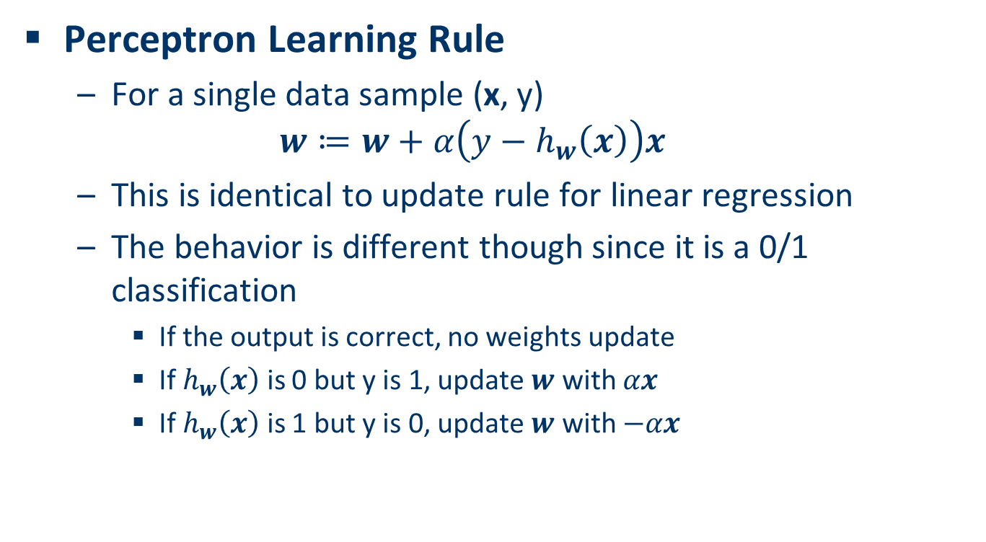
Perceptron Learning Rule
Perceptron Learning Rule
For a single data sample (x, y)
$$w≔w+α\left(y−h_{w}\left(x\right)\right)x$$
This is identical to update rule for linear regression
The behavior is different though since it is a 0/1 classification
If the output is correct, no weights update
If $h_{w}\left(x\right)$ is 0 but y is 1, update $w$ with $αx$
If $h_{w}\left(x\right)$ is 1 but y is 0, update $w$ with $−αx$

Slide 42
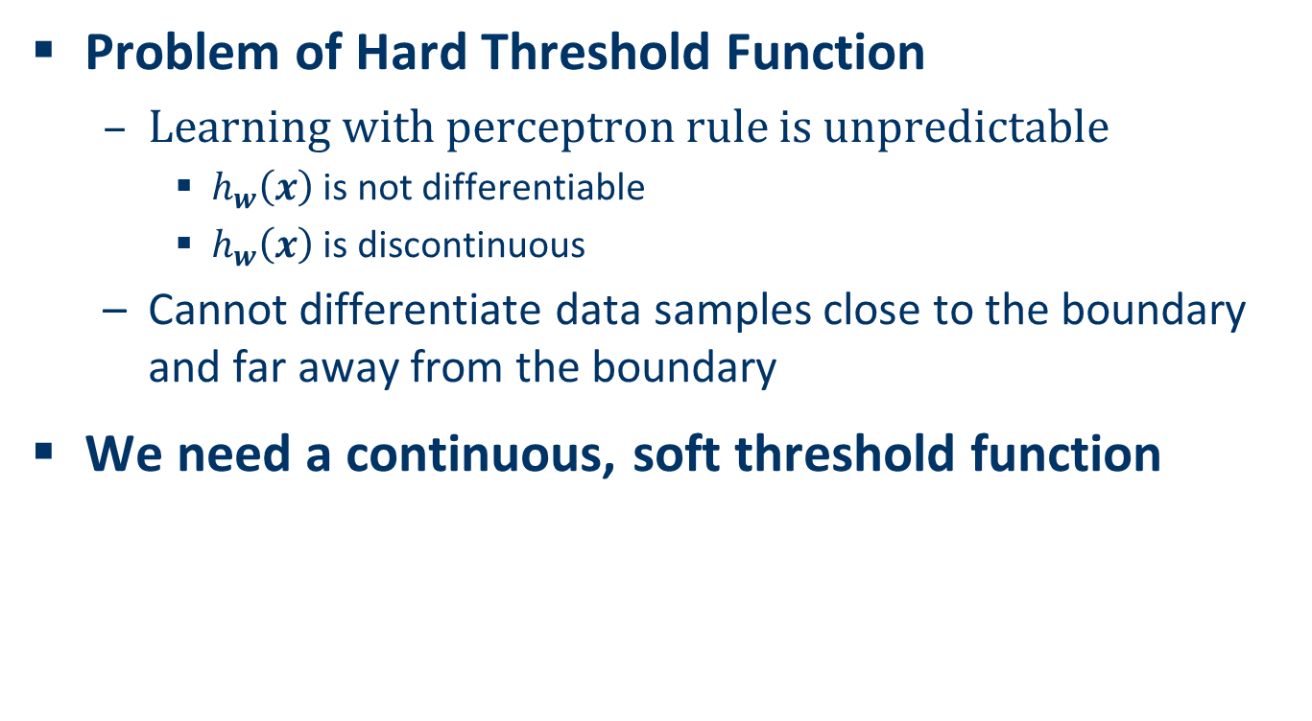
Linear Classification with Logistic Regression
Problem of Hard Threshold Function
Learning with perceptron rule is unpredictable
$h_{w}\left(x\right)$ is not differentiable
$h_{w}\left(x\right)$ is discontinuous
Cannot differentiate data samples close to the boundary and far away from the boundary
We need a continuous, soft threshold function

Slide 43
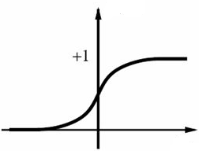

Logistic (Sigmoid) Function
Logistic (Sigmoid) Function
$$g\left(z\right)=\frac{1}{1+e^{−z}}$$
It is differentiable
$$g′\left(z\right)=g\left(z\right)(1−g\left(z\right))$$

Slide 44
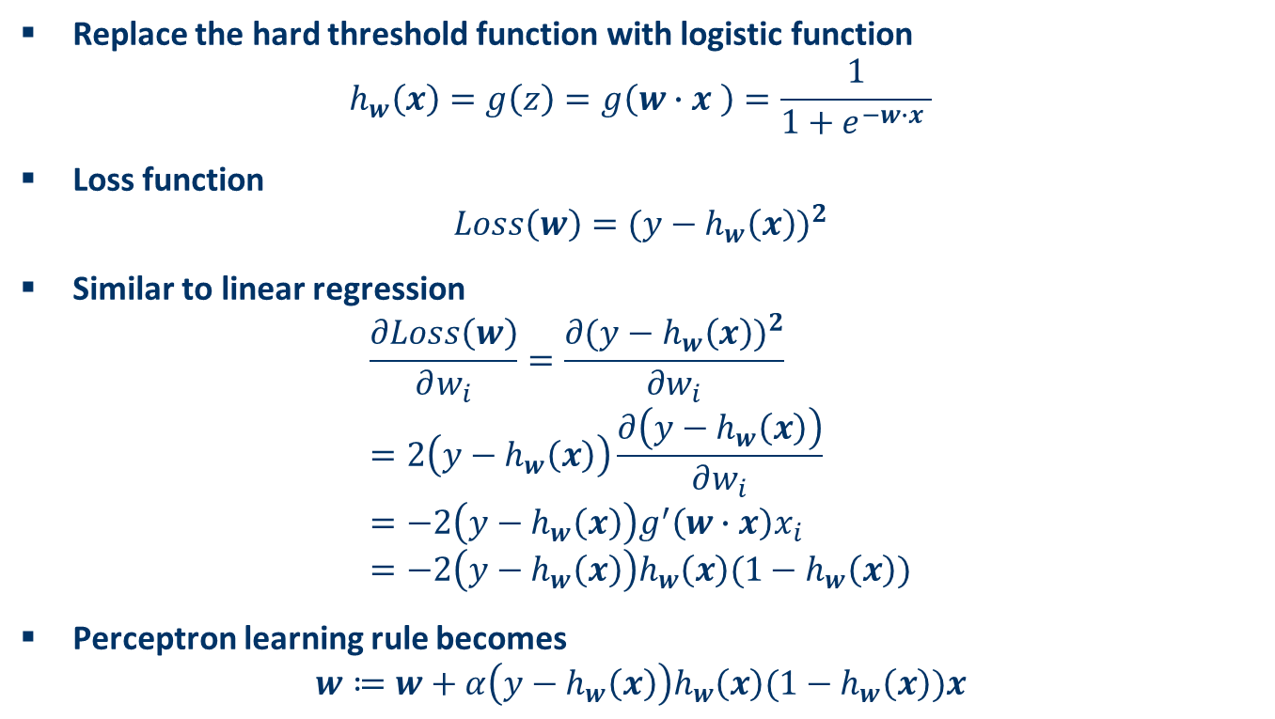
Logistic Regression
Replace the hard threshold function with logistic function
$$h_{w}\left(x\right)=g\left(z\right)=g\left(w∙x \right)=\frac{1}{1+e^{−w∙x }}$$
Loss function
$$Loss\left(w\right)={(y−h_{w}\left(x\right))}^{2}$$
Similar to linear regression
$$\frac{∂Loss\left(w\right)}{∂w_{i}}=\frac{∂{(y−h_{w}\left(x\right))}^{2}}{∂w_{i}} \\ =2\left(y−h_{w}\left(x\right)\right)\frac{∂\left(y−h_{w}\left(x\right)\right)}{∂w_{i}} \\ =−2\left(y−h_{w}\left(x\right)\right)g^{′}\left(w∙x\right)x_{i} \\ =−2\left(y−h_{w}\left(x\right)\right)h_{w}\left(x\right)(1−h_{w}\left(x\right))$$
Perceptron learning rule becomes
$$w≔w+α\left(y−h_{w}\left(x\right)\right)h_{w}\left(x\right)(1−h_{w}\left(x\right))x$$

Slide 45
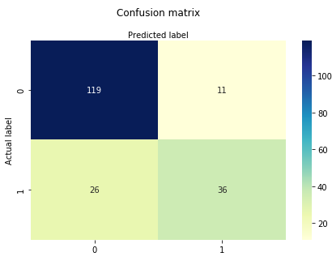
Demo of Logistic Regression
Jupyter Notebook logistic_regression

Slide 46
Introduction to Classification
The Classification Problem
Decision Tree
Random Forest
Logistic regression
Support Vector Machine (SVM)

Slide 47
Support Vector Machine
Support Vector Machine (SVM)
Linear classifiers that find a hyperplane to separate two classes of data, positive and negative.
Nonlinear separation can be done by incorporating kernel functions
Rigorous theoretical foundation
Good accuracy particularly in high dimensional data
Effective in many applications
Text classifications
Bioinformatics

Slide 48
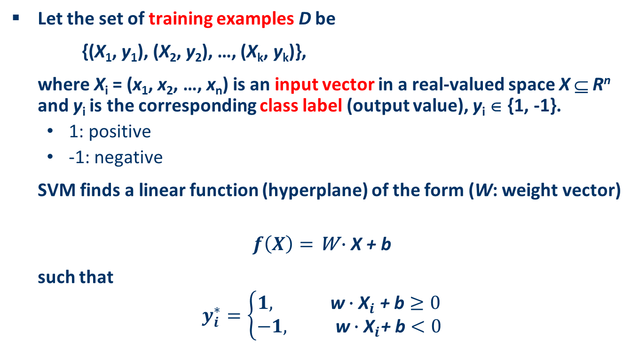
Fundamental Idea of SVM
Let the set of training examples D be
{(X₁, y₁), (X₂, y₂), …, (X_{k}, y_{k})},
where X_{i} = (x₁, x₂, …, x_{n}) is an input vector in a real-valued space X ⊆ R^{n} and y_{i} is the corresponding class label (output value), y_{i} ∈ {1, -1}.
1: positive
-1: negative
SVM finds a linear function (hyperplane) of the form (W: weight vector)
$$f\left(X\right)=\text{W}∙\text{X}\text{ + }\text{b}$$
such that
$$y_{i}^{∗}=\left\{\begin{aligned}1, \text{w}∙{\text{X}}_{i}\text{ + }\text{b}≥0 \\ &−1, \text{w}∙{\text{X}}_{i}\text{+ }\text{b}<0\end{aligned}\right.$$

Slide 49
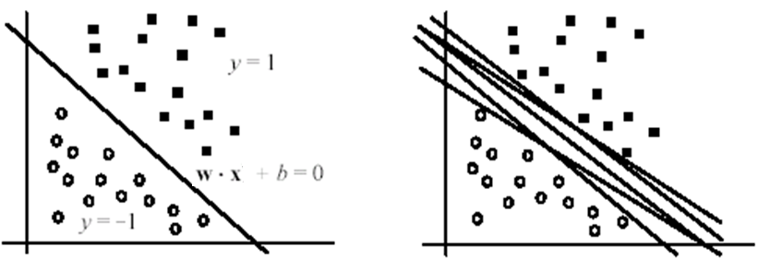

Hyperplane
The hyperplane (a.k.a. decision boundary or decision surface)
$$\text{W}∙\text{X}\text{ + }\text{b} \text{= }\text{0}$$
Many possible hyperplanes

Slide 50
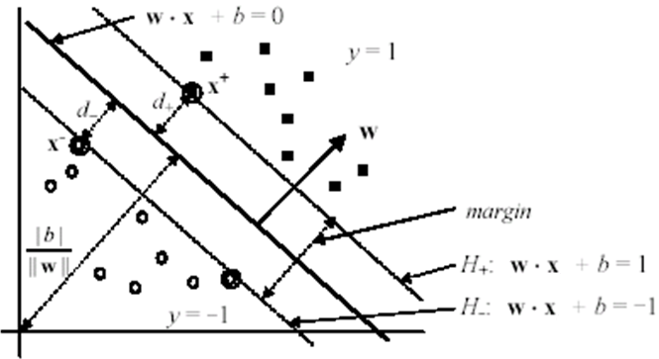
Maximal margin hyperplane
Separating hyperplane with the maximum margin
Minimizing the error bound
Machine learning theory

Slide 51
SVM for Nonlinear Separation
The theory behind SVM is linear separation
Many applications need nonlinear separation
The idea
(non-linearly) transform the input data (input space) into feature space
Much higher dimension
so that a linear decision boundary can separate positive and negative examples in the transformed space

Slide 52
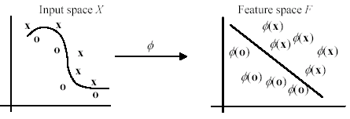
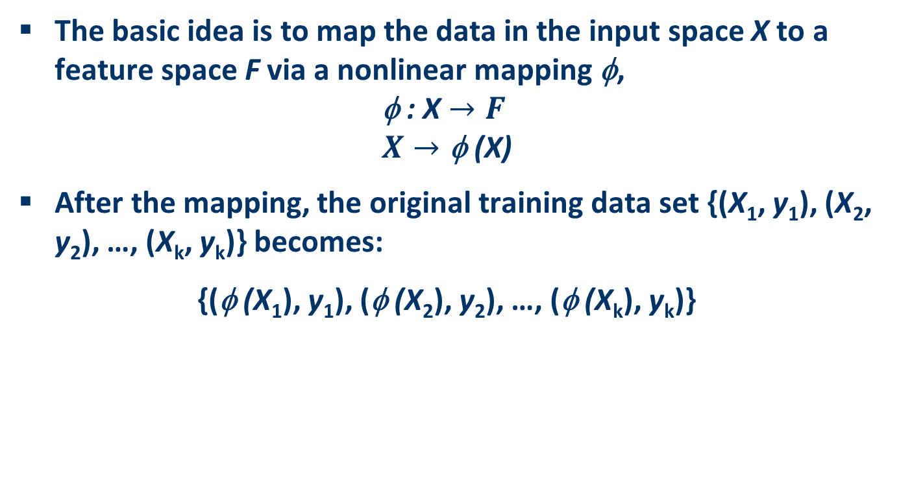
Space Transformation
The basic idea is to map the data in the input space X to a feature space F via a nonlinear mapping φ,
$$\text{}\text{ : }\text{X}→F \\ X→\text{φ}\text{ (}\text{X}\text{)}$$
After the mapping, the original training data set {(X₁, y₁), (X₂, y₂), …, (X_{k}, y_{k})} becomes:
{(φ (X₁), y₁), (φ (X₂), y₂), …, (φ (X_{k}), y_{k})}

Slide 53
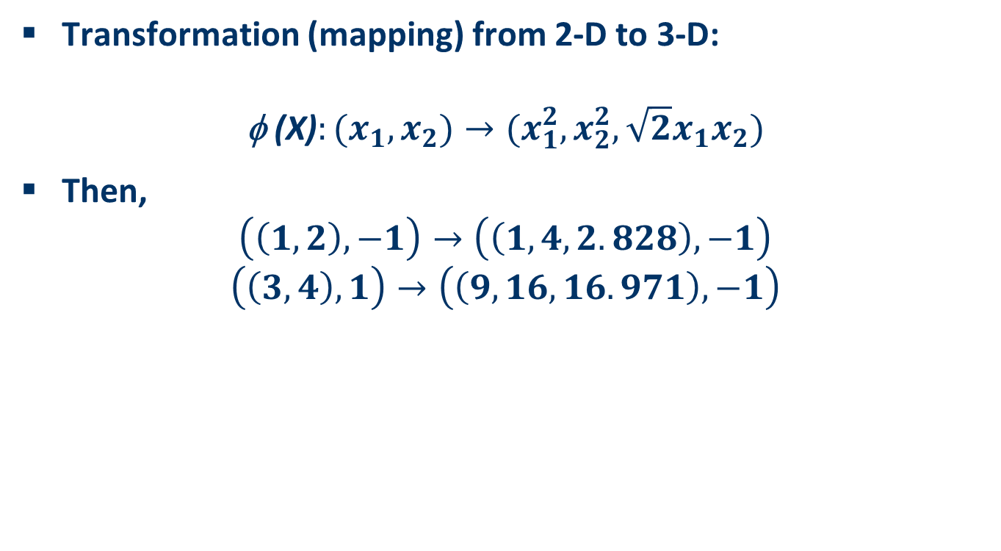
Example of 2D-3D Space Transformation
Transformation (mapping) from 2-D to 3-D:
$$\text{ (}\text{X}\text{)}:(x_{1},x_{2})→(x_{1}^{2},x_{2}^{2},\sqrt{2}x_{1}x_{2})$$
Then,
$$\left(\left(1,2\right),−1\right)→\left(\left(1,4,2.828\right),−1\right)$$
$$\left(\left(3,4\right),1\right)→\left(\left(9,16,16.971\right),−1\right)$$

Slide 54
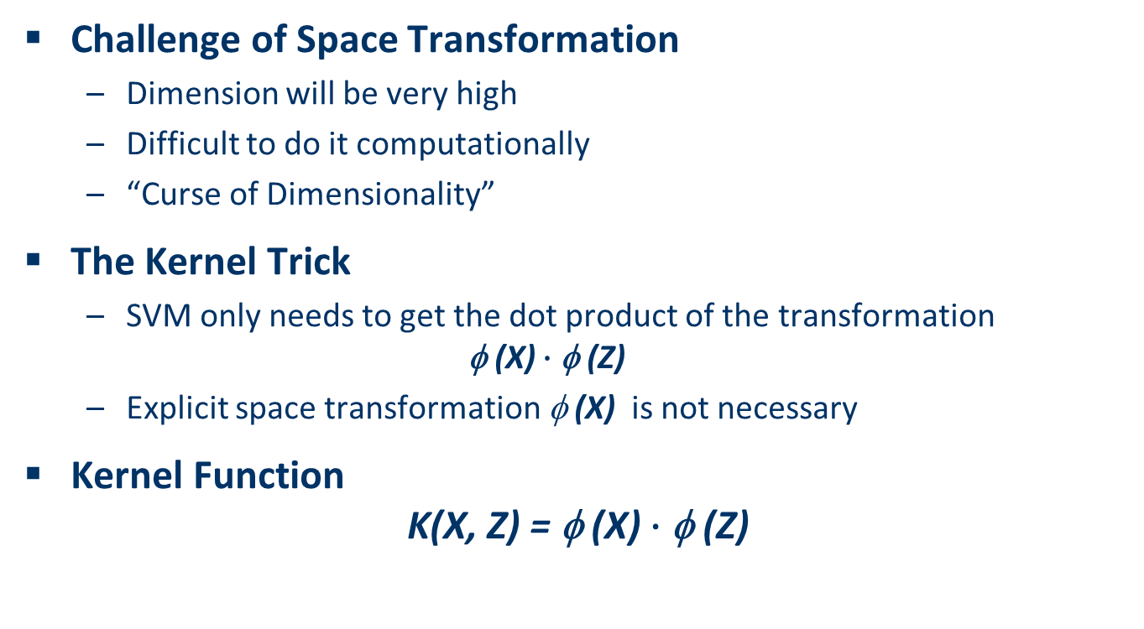
Kernel
Challenge of Space Transformation
Dimension will be very high
Difficult to do it computationally
“Curse of Dimensionality”
The Kernel Trick
SVM only needs to get the dot product of the transformation
$$\text{ (}\text{X}\text{)}∙\text{φ (}\text{Z}\text{)}$$
Explicit space transformation $\text{}\text{ (}\text{X}\text{)}$ is not necessary
Kernel Function
$$\text{K}\text{(}\text{X}\text{, }\text{Z}\text{) = }\text{φ (}\text{X}\text{)}∙\text{φ (}\text{Z}\text{)}$$

Slide 55
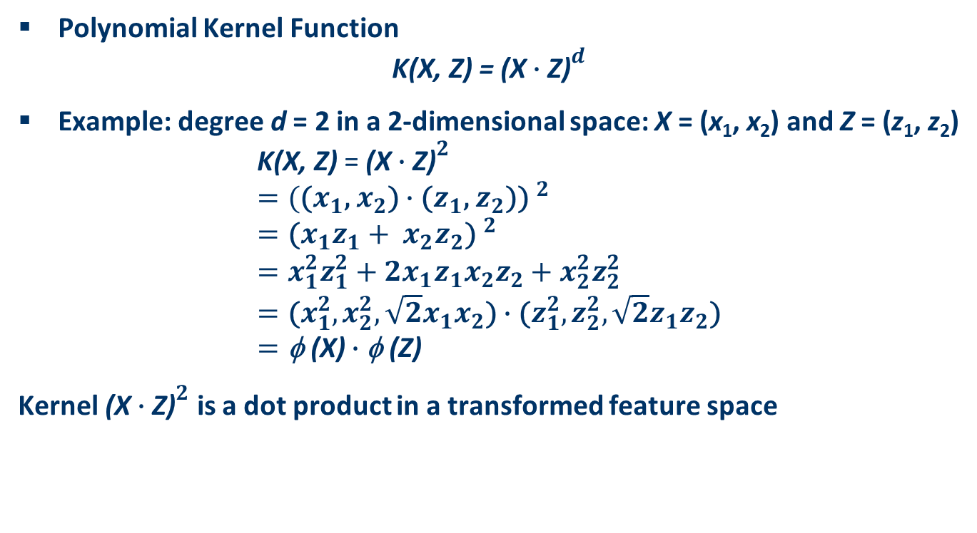
Example of Kernel Function
Polynomial Kernel Function
$$\text{K}\text{(}\text{X}\text{, }\text{Z}\text{) = }{\text{(}\text{X}∙\text{Z}\text{)}}^{d}$$
Example: degree d = 2 in a 2-dimensional space: X = (x₁, x₂) and Z = (z₁, z₂)
$$\text{K}\text{(}\text{X}\text{, }\text{Z}\text{) }\text{=} {\text{(}\text{X}∙\text{Z}\text{)}}^{2} \\ ={(\text{(}x_{1}\text{,}{ x}_{2}\text{)}∙\text{(}z_{1}\text{,}{ z}_{2}\text{))} }^{2} \\ ={\text{(}x_{1}z_{1}+{{ x}_{2}z}_{2}\text{)} }^{2} \\ =x_{1}^{2}z_{1}^{2}+2x_{1}z_{1}{x_{2}z}_{2}+x_{2}^{2}z_{2}^{2} \\ =\text{(}x_{1}^{2},x_{2}^{2},\sqrt{2}x_{1}x_{2}\text{)}∙\text{(}z_{1}^{2},z_{2}^{2},\sqrt{2}z_{1}z_{2}\text{)} \\ =\text{φ (}\text{X}\text{)}∙\text{φ (}\text{Z}\text{)}$$
Kernel ${\text{(}\text{X}∙\text{Z}\text{)}}^{2}$ is a dot product in a transformed feature space

Slide 56
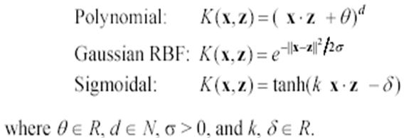
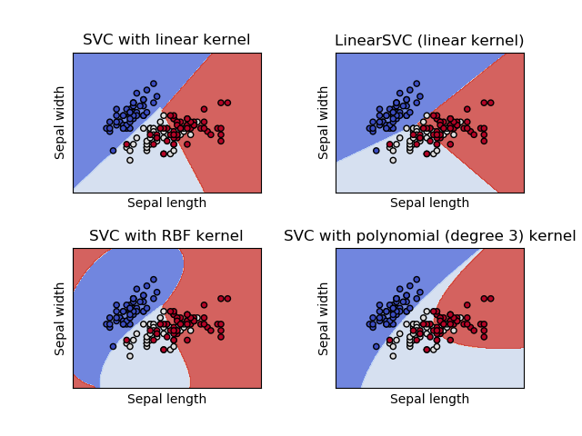
Commonly Used Kernel Functions

Slide 57
Demo
Jupyter notebook SVM

Slide 58
Disadvantages of SVM
SVM only works in real-valued space
Need to convert categorical values to numeric values
SVM only does two-class classification
Need to do multiple binary classifications for multi-class problems
Hyperplane is hard to interpret
Harder when kernels are used

Slide 59
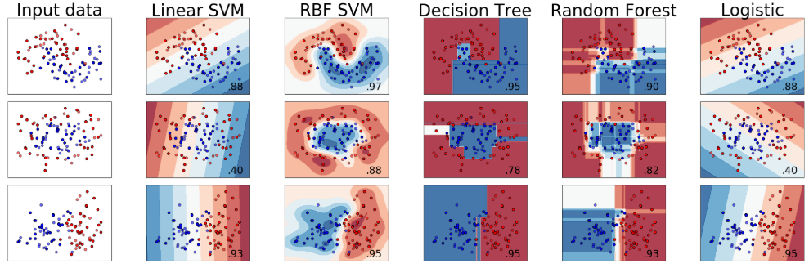
Demo: Classifier Comparison
Jupyter Notebook Classifier_Comparison

Slide 60
Summary
The Classification Problem
Decision Tree
Random Forest
Logistic regression
Support Vector Machine (SVM)
Comparison of Classifiers

